Slide 1
Disability Services for Students
(DSS)
Brent Boyer, M.A.
Director

Slide 2
Overview
Meet the DSS Staff
DSS Highlights
Common Accommodations
Support Services
Differences between high school and college
How to access DSS
FAQs
Next steps - Questions?

Slide 3
Meet the DSS Staff Members
Brent Boyer, M.A. - Director
Christy Giambastiani - Senior Disability Management Advisor
Michael Eynon, M.A. - Testing Coordinator
Mary Lenoir, M.A. - Disability Management Advisor
Sydney Johnston, M.S. - Disability Management Advisor
Noelia Franzen, M.A. Ed. - Senior Accessibility Coordinator
Stephanie Graham - Accessibility Specialist
Ellie Orona - Student Access & Success Specialist

Slide 4
DSS Highlights
672 students served - 11.5% of the student population.
Dean’s List recipients
Student government
Student athletes
Peer Mentors
Study away participants
Performing arts & music
Research & Internships
SSU DSS - the only office within the CSU who also provides academic advising to our students.

Slide 5
Common Accommodations
Additional time for timed exams or quizzes.
Reduced distraction testing environment in the DSS office.
Academic advising for all students.
Note taking assistance.
Alternate media.
Captioning.
Adaptive furniture - chairs/tables.
ADA Campus housing & dietary accommodations.

Slide 6
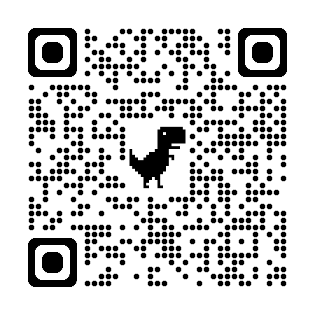
Support Services
TRIO Support Services
  Provide professional 1:1 support in math, reading, and writing.
Learning and Academic Support Center (LARC)
  Tutoring, Writing Center, Supplemental Instruction (embedded in some courses).
Counseling and Psychological Services.
Department of Rehabilitation (DOR).

Slide 7
Comparison of High School & College Services for Students with Disabilities - Who is Responsible?
Parents or teachers often initiate disability-related services.
Students “sometimes” are not actively involved in their educational plan.
Students need to initiate services, rather than parents.
Students do not have to disclose that they have a disability, however, they must do so with DSS if they want to receive academic accommodations.

Slide 8
Comparison of High School & College Services for Students with Disabilities - Disability Documentation
High school IEP or 504 Plan is generally not sufficient documentation by itself to document a disability.
Schools set reasonable standards for documentation requirements.
Documentation should be prepared by an appropriate professional such as a medical doctor, psychologist, etc.
Individualized Educational Plan (IEP) or Section 504 Plan identify services and/or accommodations.

Slide 9
Comparison of High School & College Services for Students with Disabilities - Accommodations
Academic adjustments may include auxiliary aids or modifications as necessary to ensure equal educational opportunity, but not lower expectations or fundamentally alter the requirements of of the program/class.
Examples include: Extended time for testing, note taking assistance, sign language interpreters, alternate formatetted materials, etc.
“Guarantee access - not success.”
When modifications are made, students with disabilities may not be expected to master the same academic content as others in the classroom - it is important to know whether courses or modifications are meeting college requirements.
Guarantee success by modifying curriculum.

Slide 10
Comparison of High School & College Services for Students with Disabilities - Determining Accommodations
Classroom accommodations may be formally developed through IEP or 504 Plans. Some teachers may informally agree to provide accommodations in their classrooms.
Academic accommodations are based on functional limitations identified in the student’s formal assessment (e.g. Learning disability testing).
DSS Advisor provides the student and faculty with an accommodation letter outlining appropriate accommodations for each class.

Slide 11
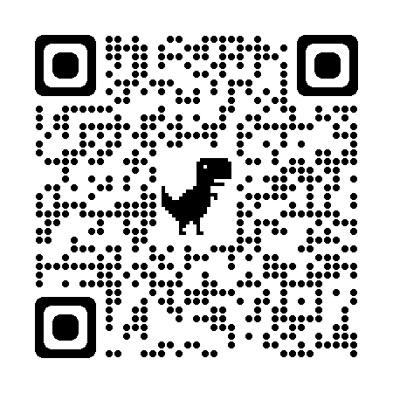
How to Get Started with DSS:
It is as Easy as 1, 2, 3.
The Student Information Form provides DSS with general information about yourself, impact of your condition, accommodation history, and anticipated need for specific accommodations as they relate to your condition.
The form may be completed online: https://dss.sonoma.edu/register-services
Please call the office at 707-664-2677, to schedule a “Prospective Student” appointment.

Slide 12
Frequently Asked Questions
What is accommodation letter?
When is a student required to notify faculty of a need for accommodations?
Do faculty have access to my records and know about my personal situation?
Is there ever a cut-off for when I may seek accommodations during the semester? Do faculty have to provide these accommodations?
Other questions?

Slide 13
Next Steps
Apply online at Cal State Apply.
Check your email for an automated application receipt and updates on the status of your application.
Check your MySSU account for updates, requirements, and deadlines.
Schedule new student orientation & registration for classes.
Register with DSS.

Slide 14
How to Contact Us
Schulz 1014A (Bottom floor of the library)
Office Hours: Monday - Friday, 8:00 AM to 5:00 PM
Phone: (707) 664-2677 (Dial 711 for Relay)
Fax: (707) 664-3330
Email: disability.services@sonoma.edu
Thank you for stopping by!

